Slide 1
An Introduction To…. Effective Leadership – It’s Not Just “Bossing” Anymore!
Iowa state association of counties
Presented by forst training & consulting

Slide 2
“I DON’T HAVE TIME FOR THIS!”

Slide 3
The Law of the Lid

Slide 4
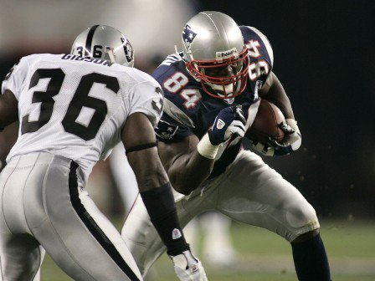

Slide 5
Generations in the Workplace

Slide 6
Baby Boomers
Ages 51-70

Slide 7
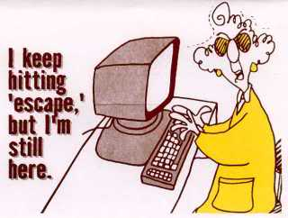

Slide 8
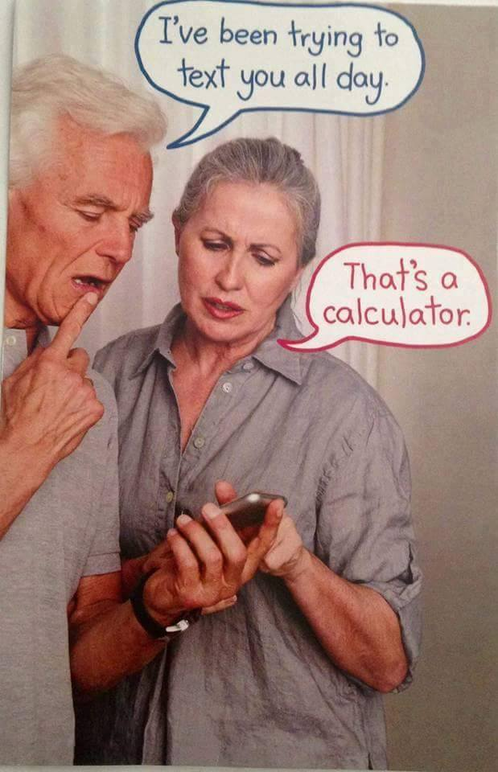

Slide 9
Gen Xers
Ages 31-50

Slide 10
Millenials
Ages 21-30

Slide 11
“Tough Guy” Leader

Slide 12
“Nice Guy” Leader

Slide 13
Effective Leaders….
Energize
Empower
Support
Communicate

Slide 14
Difference Between
Boss
Leader
Drives Employees
Depends on Authority
Inspires Fear
Says, “I”
Places blame for breakdown
Knows how it’s done
Uses People
Takes Credit
Commands
Says, “Go”
Coaches Them
Depends on Goodwill
Generates Enthusiasm
Says, “We”
Fixes the Breakdown
Shows how it’s Done
Develops People
Gives Credit
Asks
Says, “Let’s Go”

Slide 15
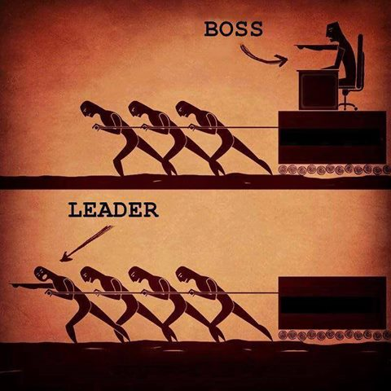

Slide 16
Someone You Work Well With…..

Slide 17
Someone Who Drives You NUTS!

Slide 18
The Workplace Divide
Results Oriented
Relationship Oriented

Slide 19
Results Oriented People….
Task Focused, Less Emotional & Less Relational
More Formal, Less Social / Keep Their Personal & Work
Lives Separate
Driven by Results and Making the Right Decision
Prefer to Avoid “Fluff” in Getting Their Desired Result
Can Easily Become Impatient and Frustrated with People

Slide 20
Relationship Oriented People…
People Focused, Relational & More Emotional
Passionate and Enthusiastic
More Informal, More Social / Blend Personal and Work Lives
Driven by Positive Experiences they have with Others
When don’t feel appreciated and in harmony with people, they can easily take things too Personally

Slide 21
Results Oriented People….
“Why are they SO emotional?!”
“Why can’t they just stay focused?!”
“Do we need to talk EVERYTHING to death?”
“It’s not a big deal!”
“Why are they so NEEDY?!”

Slide 22
Relationship Oriented People….
“Why are they so serious and uptight all the time?!”
“It’s not about the money….”
“Don’t they care about PEOPLE?!”
“Are they mad at me?”
“They are just not very friendly….”

Slide 23
Every Interaction…
Personal Needs
Practical Needs
Be Heard & Understood
Be Respected & Valued
Trust and be Trusted
Be Involved in Discussion & Related Decisions
Communication
Getting the Job Done

Slide 25
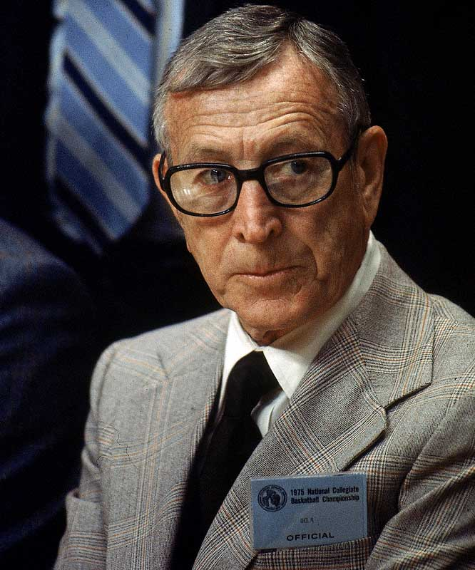

Slide 26
